Slide 1
Lecture 3

Slide 2
International Arbitrage
Defined as capitalising on a discrepancy in quoted prices by making a riskless profit
Arbitrage will cause prices to realign
Three forms of arbitrage:
  Locational arbitrage
  Triangular arbitrage
  Covered interest arbitrage.

Slide 3
International Arbitrage
Locational Arbitrage
Defined as the process of buying a currency at the location where it is priced cheap and immediately selling it at another location where it is priced higher
Gains from locational arbitrage are based on the amount of money used and the size of the discrepancy
Realignment due to locational arbitrage drives prices to adjust in different locations so as to eliminate discrepancies

Slide 4
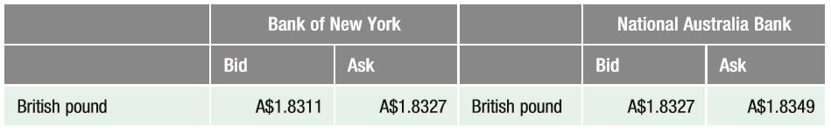
Currency Quotes for Locational Arbitrage Example

Slide 5
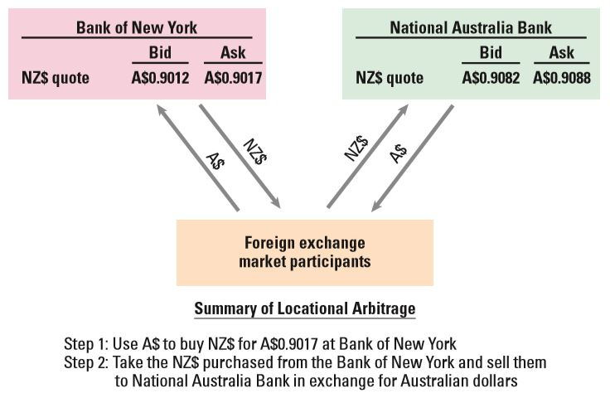
Locational Arbitrage

Slide 6
International Arbitrage
Triangular Arbitrage
Defined as currency transactions in the spot market to capitalise on discrepancies in the cross exchange rates between two currencies
Gains from triangular arbitrage: Currency transactions are conducted in the spot market to capitalise on the discrepancy in the cross exchange rate between two countries
Accounting for the Bid/Ask Spread: Transaction costs (bid/ask spread) can reduce or even eliminate the gains from triangular arbitrage
Realignment due to triangular arbitrage forces exchange rates back into equilibrium

Slide 7
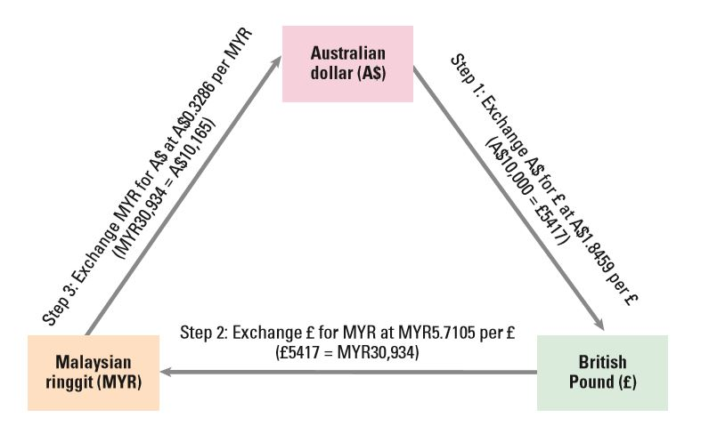
Example of Triangular Arbitrage

Slide 8
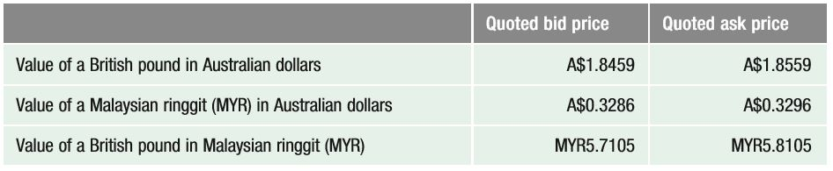
Currency Quotes for a Triangular Arbitrage Example with Transaction Costs

Slide 9
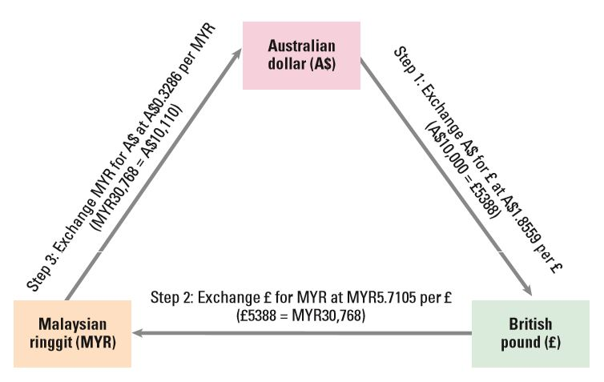
Example of Triangular Arbitrage Accounting for Bid/Ask Spreads

Slide 10
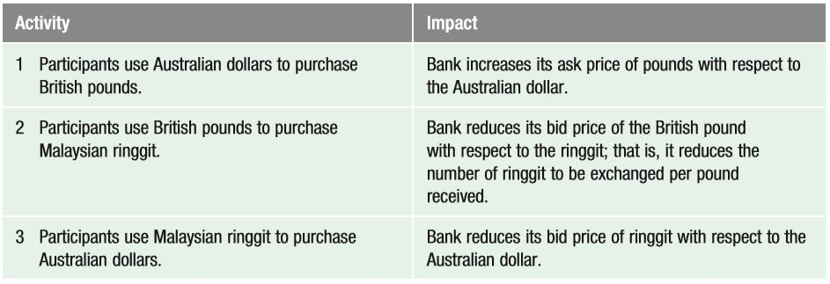
Impact of Triangular Arbitrage

Slide 11
International Arbitrage
Covered Interest Arbitrage
Steps involved in covered interest arbitrage
  Defined as the process of capitalising on the interest rate differential between two countries while covering your exchange rate risk with a forward contract
  Consists of two parts:
    Interest arbitrage: the process of capitalising on the difference between interest rates between two countries
    Covered: hedging the position against interest rate risk.
Realignment due to covered interest arbitrage causes market realignment
Timing of realignment may require several transactions before realignment is completed

Slide 12
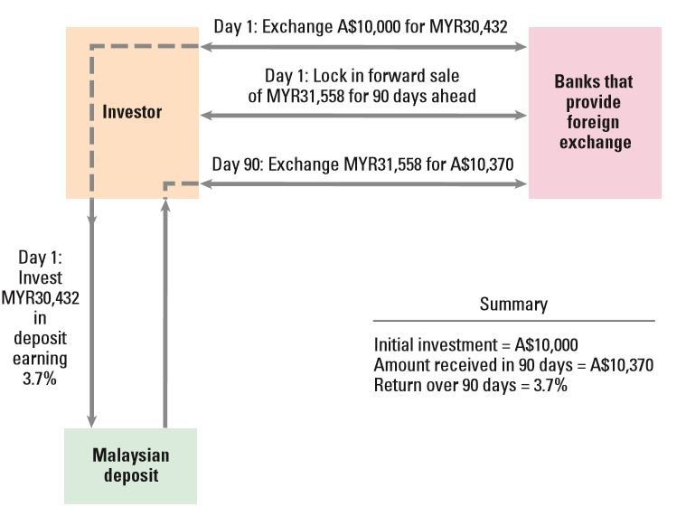
Example of Covered Interest Arbitrage

Slide 13
International Arbitrage
Covered Interest Arbitrage Realignment is focused on the forward rate
  The forward rate is likely to experience most if not all of the adjustment needed to achieve realignment
Accounting for spreads
  Investor must account for the effects of the spread between the bid and ask quotes and of the spread between deposit and loan rates
Covered interest arbitrage by Non-Australian investors
    The concept of covered interest arbitrage applies to any two countries for which there is a spot rate and a forward rate between their currencies as well as risk-free interest rates quoted for both currencies

Slide 14
International Arbitrage
Comparison of Arbitrage Effects
The threat of locational arbitrage ensures that quoted exchange rates are similar across banks in different locations
The threat of triangular arbitrage ensures that cross exchange rates are properly set
The threat of covered interest arbitrage ensures that forward exchange rates are properly set. Any discrepancy will trigger arbitrage, which should eliminate the discrepancy
Thus, arbitrage tends to allow for a more orderly foreign exchange market

Slide 15
International Arbitrage
Comparison of Arbitrage Effects
How arbitrage reduces transaction costs
  Locational arbitrage limits the differences in a spot exchange rate quotation across locations.
  Covered interest arbitrage ensures that the forward rate is properly priced.

Slide 16
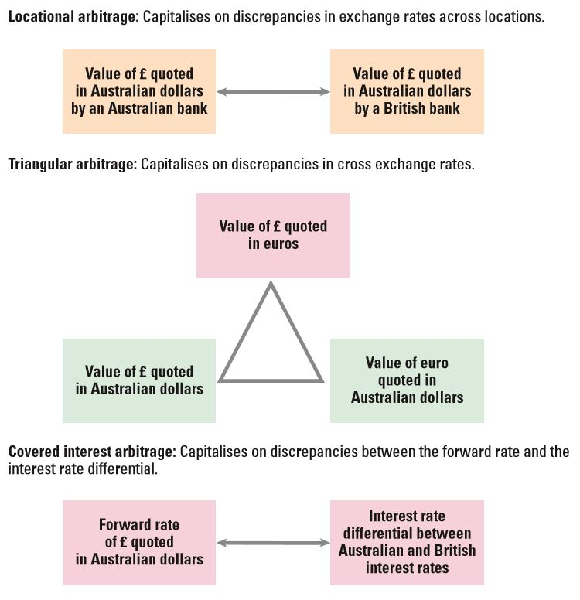
Comparing Arbitrage Strategies

Slide 17
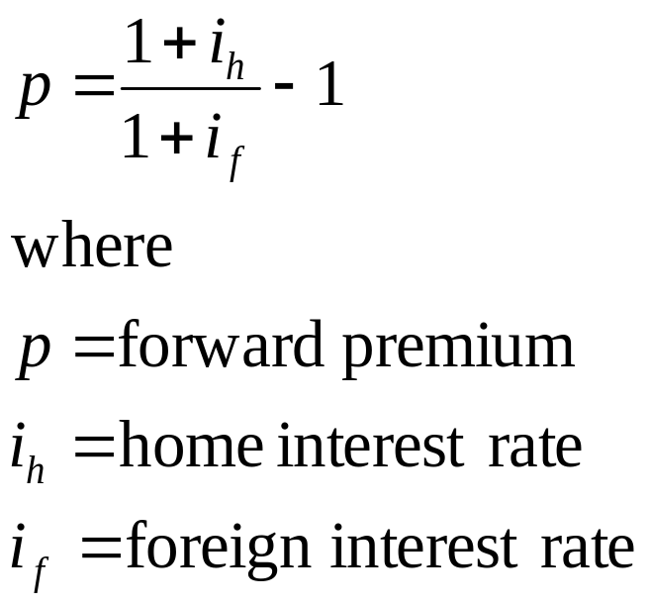
Interest Rate Parity
In equilibrium, the forward rate differs from the spot rate by a sufficient amount to offset the interest rate differential between two currencies.
Derivation of Interest Rate Parity

Slide 18
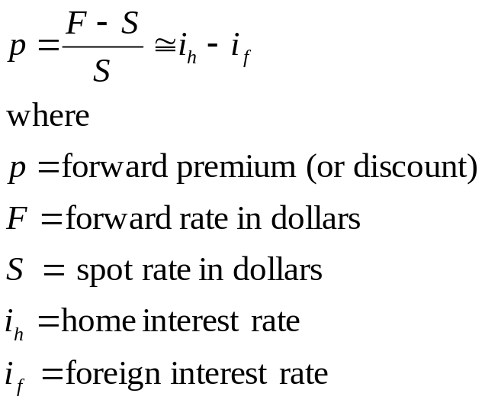
Interest Rate Parity
Determining the Forward Premium
Effect of the interest rate differential: The relationship between the forward premium (or discount) and the interest rate differential according to IRP is simplified in an approximated form:
Implications: If the forward premium is equal to the interest rate differential as just described, then covered interest arbitrage will not be feasible.

Slide 19
Interest Rate Parity
Graphic Analysis of Interest Rate Parity
Points representing a discount: points A and B
Points representing a premium: points C and D
Points representing IRP: points A, B, C, D
Points below the IRP line: points X and Y
  Investors can engage in covered interest arbitrage and earn a higher return by investing in foreign currency after considering foreign interest rate and forward premium or discount
Points above the IRP line: point Z
  Australian investors would achieve a lower return on a foreign investment than on a domestic one

Slide 20
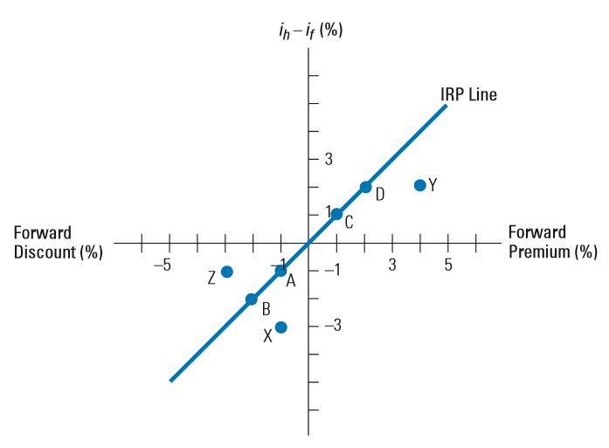
illustration of interest rate parity

Slide 21
Interest Rate Parity
How to Test Whether Interest Rate Parity Holds
  The location of the points provides an indication of whether covered interest arbitrage is worthwhile
  For points to the right of the IRP line, investors in the home country should consider using covered interest arbitrage, since a return higher than the home interest rate (i_{h}) is achievable
  Of course, as investors and firms take advantage of such opportunities, the point will tend to move toward the IRP line
  Covered interest arbitrage should continue until the interest rate parity relationship holds

Slide 22
Interest Rate Parity
Interpretation of Interest Rate Parity
  Interest rate parity does not imply that investors from different countries will earn the same returns
Does Interest Rate Parity Hold?
  Compare the forward rate (or discount) with interest rate quotations occurring at the same time. Due to limitations in access to data, it is difficult to obtain quotations that reflect the same point in time

Slide 23
Interest Rate Parity
Considerations When Assessing Interest Rate Parity
Transaction costs
  The actual point reflecting the interest rate differential and forward rate premium must be farther from the IRP line to make covered interest arbitrage worthwhile
Political risk
  A crisis in the foreign country could cause its government to restrict any exchange of the local currency for other currencies
Differential tax laws
  Covered interest arbitrage might be feasible when considering before-tax returns but not necessarily when considering after-tax returns

Slide 24
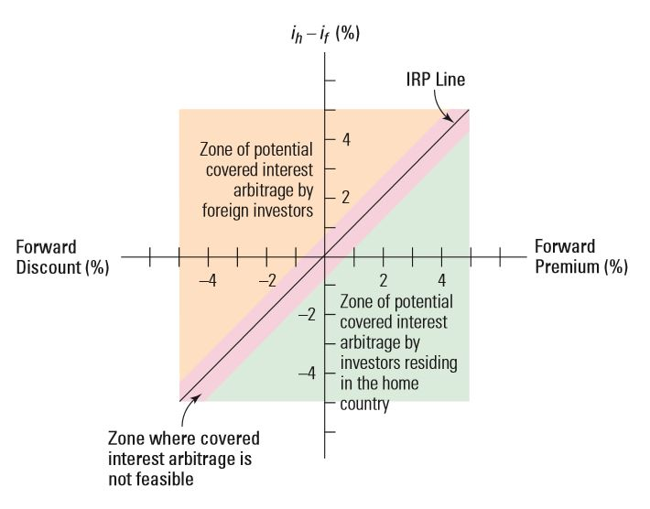
Potential for Covered Interest Arbitrage When Considering Transaction Costs

Slide 25
Variation in Forward Premiums
Forward Premiums across Maturities
  The annualised interest rate differential between two countries can vary among debt maturities, and so will the annualised forward premiums
Changes in Forward Premiums over Time
  Next figure illustrates the relationship between interest rate differentials and the forward premium over time, when interest rate parity holds. The forward premium must adjust to existing interest rate conditions if interest rate parity holds
Explaining changes in the forward rate
    The forward rate is indirectly affected by all the factors that can affect the spot rate (S) over time, including inflation differentials, interest rate differentials, etc. The change in the forward rate can also be due to a change in the premium

Slide 26
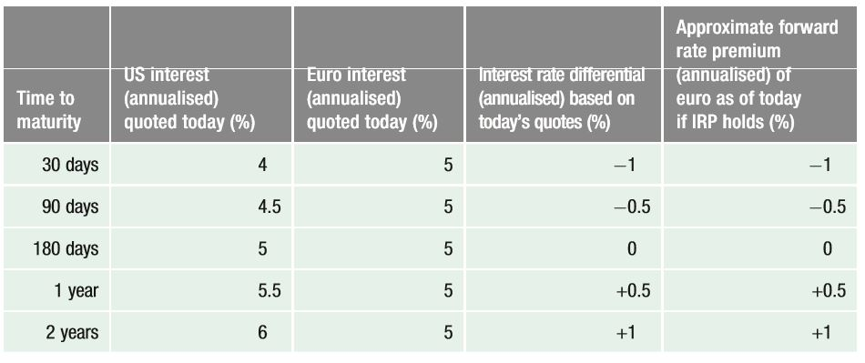
Quoted Interest Rates for Various Times to Maturity

Slide 27
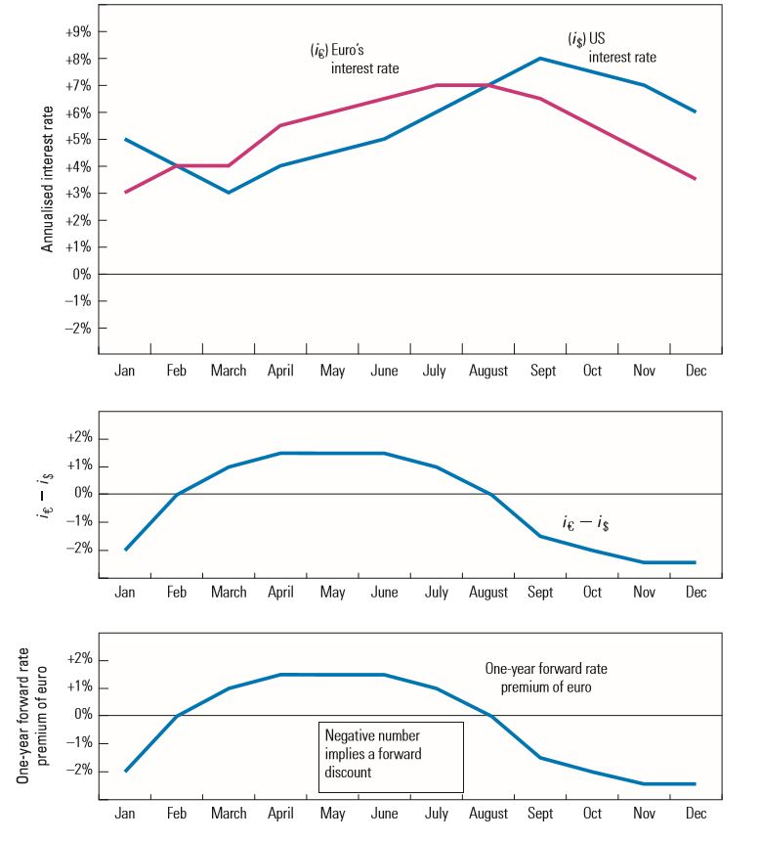
Relationship over Time between the Interest Rate Differential and the Forward Premium

Slide 28
Comparison of the irp, ppp and ife
Although all three theories relate to the determination of exchange rates, they have different implications
  IRP focuses on why the forward rate differs from the spot rate and on the degree of difference that should exist. It relates to a specific point in time
  PPP and IFE focus on how a currency’s spot rate will change over time
  Whereas PPP suggests that the spot rate will change in accordance with inflation differentials, IFE suggests that it will change in accordance with interest rate differentials
  PPP is related to IFE because expected inflation differentials influence the nominal interest rate differentials between two countries

Slide 29
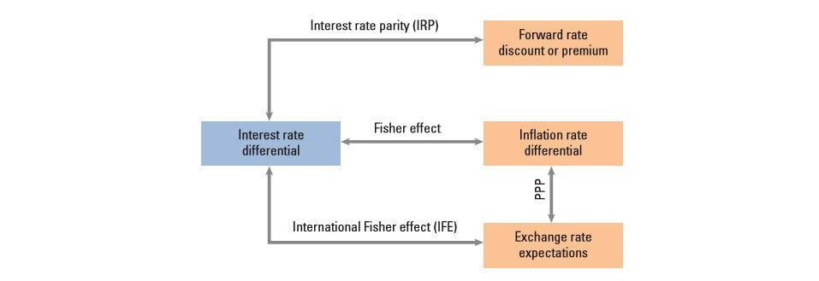
comparison of the irp, ppp and ife theories
1/2

Slide 30
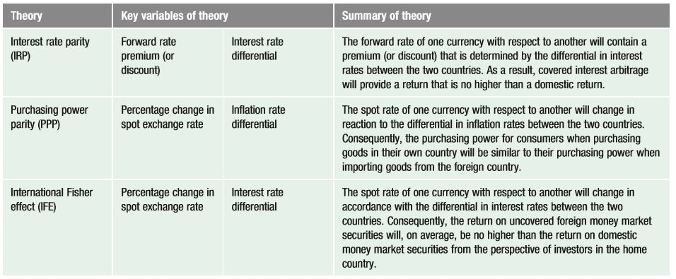
comparison of the irp, ppp and ife theories

